Slide 1
Week7:
Lesson 1: Percentage composition

Slide 2
The chemical formula of a compound gives information about the elements present in a compound and the ratio in which the atoms of those elements are present.
E.g. in phosphoric acid ( H₃PO₄), H, P and O are present in the ratio 3:1:4.
The percentage composition of a compound is the percentage by mass of each of the different elements in the compound.

Slide 3
Calculating percentage composition
The percentage composition can be calculated from the chemical formula and the relative atomic masses of the elements in the compound.
This composition is independent of how much of the compound there is.
Look at worked example 5.3 from page: 234 and do Question set: 5.2 Q’s 1,2 and 3 (b)

Slide 4
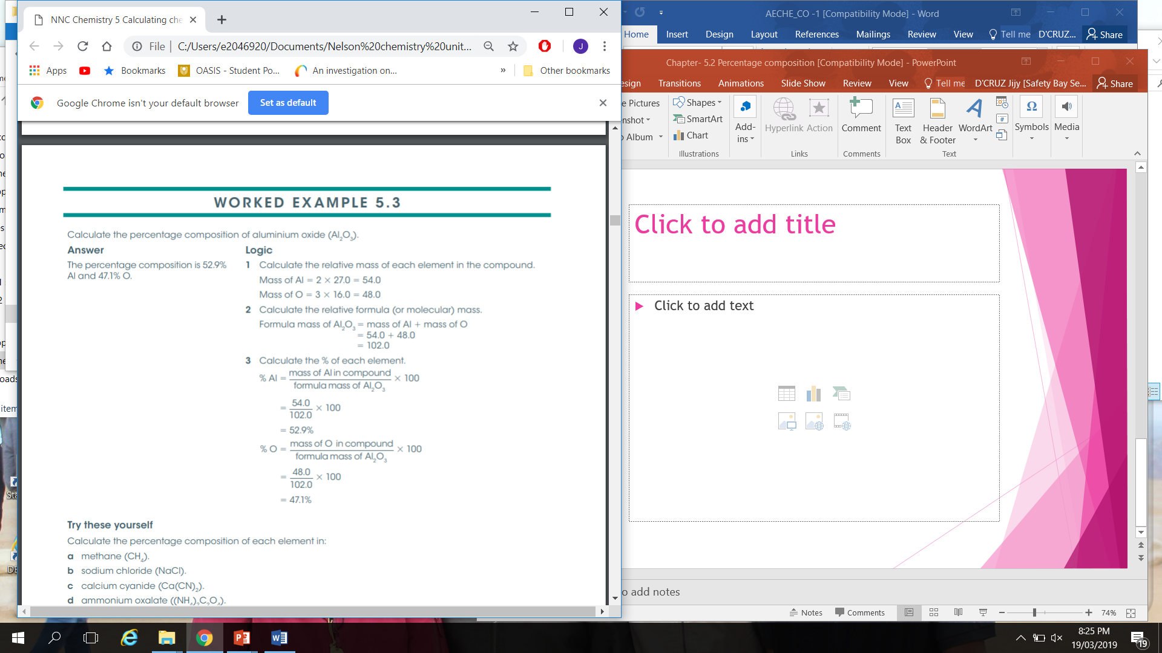

Slide 5
Homework
Complete questions from Set: 5 Q: 10
Check Example 8 and 9 from EC: P: 30
Complete Q:12 (a) from P: 32
Do Q: 2 (I, j, r) from P: 30
Q: 6 (e, c, I)
Q: 9( a, d, h, m, r)

